Slide 1


COURSE PROJECT PORTFOLIO
AI Foundation for Engineers
Practical Implementation of AI Workflows & Modern Frontend Engineering
PROJECT DEVELOPERS
Akash babji
Aryush Sheelavant
Kavya bist
Anjali Nair PM
R25EJ006
R25EJ017
R25EJ054
R25EJ008
REVA UNIVERSITY
CSE 2026

Slide 2






Course Portfolio Architecture System Blueprint
A progressive four-phase computational framework structured to transition traditional logic mechanisms into cloud environments, emphasizing robust source control, deep model card teardowns, and optimized interfaces.
Technical Foundations
AI Model Analysis
Frontend Autonomy
Project 1: Git Staging & Storing
Project 2: Hugging Face Cards
Projects 3 & 4: Interface Design
Establishing robust local-to-remote control systems, keys, and logical staging workflows for structured engineering pipelines.
Comprehensive vision-language parameters exploration, decoding analysis, and comparative benchmarking models.
Building serverless layout grids and content aggregation layers using high-performance vanilla script without bundle overhead.
PROJECT ARCHITECTURE
SLIDE 02

Slide 3







Capability Node Map Core Specializations
Our structured collaborative profiles span automated staging operations, model telemetry, fluid viewport styling, and programmatic DOM optimization.
Akash babji
Aryush S.
Kavya bist
Anjali Nair PM
USN: R25EJ006
USN: R25EJ017
USN: R25EJ054
USN: R25EJ008
Commands robust Git repositories, managing atomic commits, conflict-prevention mechanisms, and server endpoints setup.
Specializes in model card analytics, hardware telemetry benchmarks, and Parallel Box Decoding architecture analysis.
Owns the native layout styling parameters, visual system design, and multi-viewport fluid alignment strategies.
Controls vanilla DOM engine mechanisms, client-side dynamic search routines, and low-latency API integration states.
TEAM ROLES
SLIDE 03

Slide 4


Project 1: Version Control & Git Staging & Delivery
Establishing Robust Repository Staging Structures
Standardized version control habits avoid code collision. We implemented secure authentication layers, local sandbox staging trees, and automated sync routines to stabilize production loops.
Identity & Keys: Secure local SSH keypair setup preventing unauthorized branch commits.
Sync Protocols: Continuous upstream synchronization to minimize branch conflicts.
Atomic Commits: Commits scoped to clear milestones, avoiding massive code dumps.
VERSION CONTROL
SLIDE 04

Slide 5



Project 2: Multimodal Model Card Core Analytics
Our analysis explored LocateAnything-3B (NVLabs), checking model footprint, dataset training scales, and real-time execution bounds.
Scale Metrics & Corpora
Task Competencies
The model was trained using 12 Million high-resolution unique visual resources, handling over 138 Million linguistic training alignments and 785 Million point-based annotations to guarantee robust object positioning capability.
Outstanding operational response in bounding-box spatial detection, precision OCR document processing, web-element identification, and structured visual layout translation across varying edge client parameters.
MODEL EVALUATION
SLIDE 05

Slide 6


Deep Dive: Parallel Box Decoding Performance Jumps
Resolving Autoregressive Grid Bottlenecks
Standard architectures process bounding coordinates sequentially ( ), generating significant latency overhead. Parallel Box Decoding (PBD) addresses this directly.
Single-Step Output: Solves coordinate generation simultaneously in a single forward calculation pass.
INFERENCE TELEMETRY INCREASE
VRAM Optimization: Reduces memory-cache footprint, allowing seamless edge-device translation.
LATENCY ANALYSIS
SLIDE 06

Slide 7


Project 3: E-Profile Layout Architecture Sleek Grid Systems
We designed a serverless developer portfolio layout utilizing pure, lightweight components to maximize painting performance and ensure immediate viewport adaptability.
Zero-Framework Integration
Visual Zone Segregation
Engineered entirely on vanilla HTML5 elements and local CSS3 style variables. Eliminating dynamic JavaScript rendering overheads boosted load speeds and limited package payload bloat.
Structured structural viewport regions: glassmorphic navigation headers with backdrop-blur, adaptive SVG profile grids, and interactive vector indicators rendering developer skill parameters instantly.
PORTFOLIO PLATFORM
SLIDE 07

Slide 8
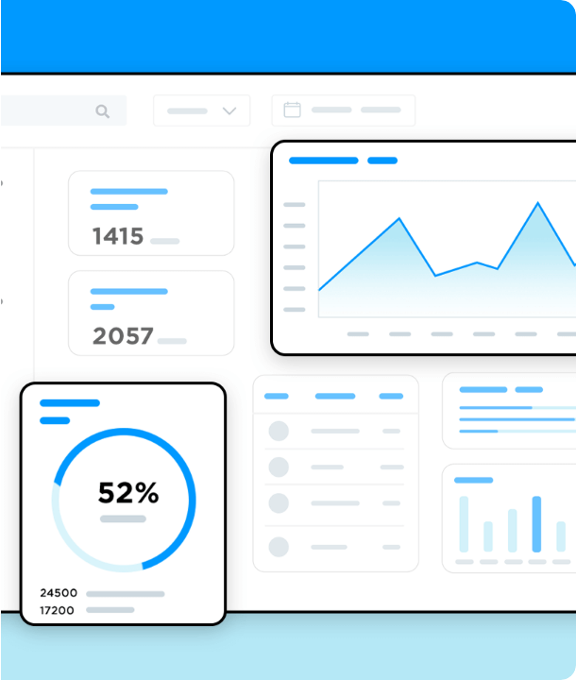
Project 4: News Platform Responsive Grid Rendering
Dynamic Interface Reshaping
We engineered a high-performance news aggregation board that dynamically restructures elements across device screens.
Breaking Tickers: Fluid banner components running CSS keyframes smoothly.
Masonry Grids: Dynamic columns prioritizing high-traffic articles.
Responsive Sidebars: Adaptive drawers collapsing dynamically based on active device parameters.
INTERFACE DEPLOYMENTS

Slide 9


Project 4: Pure JS Aggregator Engine High Performance DOM Manipulation
By removing third-party library virtual DOM layers, our aggregator directly targets and mutates native nodes to ensure lightning-fast UI updates.
Direct DOM Traversal
Query Filtering Routines
Core application logic processes local JSON dataset arrays directly, parsing raw string profiles into semantic HTML components and injection nodes in a single paint phase.
Custom client search engines map user keystrokes to dataset properties instantly, using string normalization and target class toggles with sub-millisecond lag.
VANILLA SCRIPTING
SLIDE 09

Slide 10






Unified Architecture Ecosystem Integrated Tools
An integrated developmental pipeline starting from low-level systems logic, progressing to standard staging pipelines, and final client hosting.
Deployments & Hosting
Tools & Compilers
Core Languages
GitHub Enterprise Staging
GCC Staging & Testing
C (Low-Level Core Logic)
CDN Content Delivery
Git Upstream Branches
ES6+ Javascript (Dynamic UI)
Serverless Mock API Files
Hugging Face Spaces
CSS3 Flex & Grid Engines
SYSTEM STACK
SLIDE 10

Slide 11

Thank You
Your Questions & Feedback are Welcome
Akash babji
Aryush Sheelavant
github.com/akash01-code
github.com/Django-3
Kavya bist
Anjali Nair PM
github.com/kavyabist27
github.com/pmanjalinair
REVA UNIVERSITY • CSE DEPARTMENT
END OF PRESENTATION

